Slide 1
System Development Methods CT00046-3-2
Use Case Diagram
Tutorial 9

Slide 2
Tutorial
Create a use case diagram for the Student Application System (SAS) case study.
See the next slide to find out the SAS requirements.

Slide 3
Student Application System (SAS) Case Study
You would like to create an online portal for prospective students to apply for programs at universities. There will be a list of universities in the portal for students to select from. Each university offers several programs of study. Applicants should be able to create a profile of themselves. When they are interested in a program, they will submit an application. The registry staff at the related university will first validate that the required information in the application. If the application is valid, the head of the department (HOD) of the program will approve or reject the application.

Slide 4
Unified Modeling Language (UML) Diagrams
The Unified Modeling Language (UML) is a widely used method of visualizing and documenting software systems design.
UML uses object-oriented design concepts, but it is independent of any specific programming language and can be used to describe business processes and requirements generally.
UML provides various graphical tools, such as use case diagrams, class diagrams, etc. During requirements modeling, a systems analyst can utilize the UML to represent the information system from a user’s viewpoint.

Slide 5
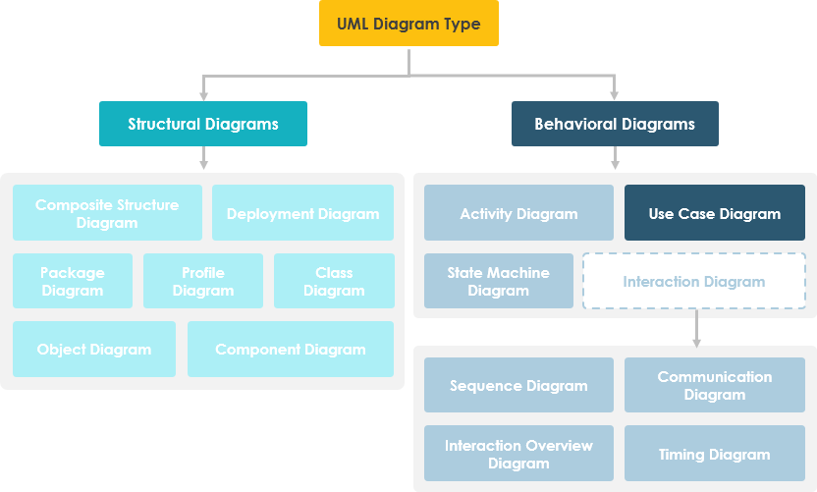
Unified Modeling Language (UML) Diagrams
Source: https://www.visual-paradigm.com/

Slide 6
Use Case Diagram
Use case diagram visually represents the interaction between users and the information system.
In a use case diagram, the user becomes an actor, with a specific role that describes how he or she interacts with the system.
Use case is an activity that the system performs, usually in response to a request by a user.
Use cases define functional requirements / systems functions / the interface between users and the system
Systems analysts can draw use case diagrams using CASE tools that integrate the use cases into the overall system design.

Slide 7
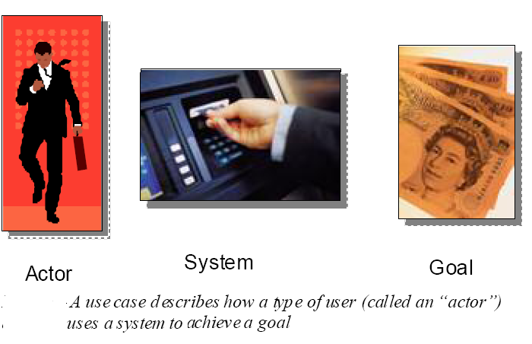
Use Case Diagram continued

Slide 8
Use Case Diagram Symbols
Use case

Slide 9
Use Case Relationships Include Relationship
Use case include is a directed relationship between two use cases which is used to show that the included use case (the addition) is inserted into the base use case.
Include relationship between use cases is shown by a dashed arrow with an open arrowhead from the including (base) use case to the included (common part) use case. The arrow is labeled with the keyword «include».

Slide 10
Use Case Relationships Extend Relationship
Extend is a directed relationship that specifies how and when the extending use case (optional) can be inserted into the base use case.
Extend relationship is shown as a dashed line with an open arrowhead directed from the extending use case to the extended (base) use case. The arrow is labeled with the keyword «extend».

Slide 11
Use Case Relationships Generalization Relationship
A generalization relationship means that a child use case inherits the behavior and meaning of the parent use case.

Slide 12
Let’s create a use case diagram for the Student Application System (SAS) case study.
Use of system modelling tool e.g., Ms. Visio, DIA, draw.io, etc.

